Slide 1
Dueling Haikus
For two contrasting topics
use no more than 17 syllables.
arrange these in lines of 5-7-5 syllables
link the words to the natural word
focus on a memorable detail of the Haiku's topic

Slide 2
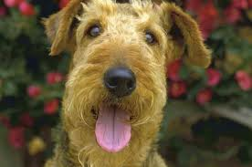
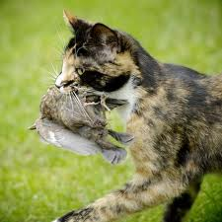
Dueling Haikus
Dog Haiku http://www.yuckles.com/bellyup.htm
I lie belly-up In sunshine, happier than You ever will be.
The mighty hunter Returns with gifts of plump birds. Your foot just squashed one.
Cat Haiku http://strangeplaces.net/weirdthings/cathaiku.html

